Slide 1
Dell Software Group "IT System Management Introduction” Lab Course
Beam Liu
Software Engineer Manager

Slide 2
Who Am I
Software development for 9+ years
Java and web development for around 5 years
Performance Monitor area for 4+ years
Working at Dell for 4+ years
Now leading the next generation of Dell’s Application Performance Monitoring dashboard development

Slide 3
Understand Application Performance Monitoring
Focus on making sure software application programs perform as expected.
Provide end user experience data from the user through the distributed application components.
Be able to monitor and trace transactions across tiers of the application.
Detect performance deviations of application components.
Notes:
http://blogs.gartner.com/jonah-kowall/2014/02/14/application-monitoring-is-not-application-performance-monitoring-apm/

Slide 4
Lab Course Arrangement
Lab course preparation
  Grouping mates
  Research used technical references
  Environment preparation
Build a prototype of APM (Application Performance Monitoring) product with part of the functionalities from zero within 3 days lab course
Finish and submit bonus tasks

Slide 5
APM Prototype
High-level Requirement
  There is a website running slowly in tomcat, however, the site administrator has no concept of that, he/she does not know how to begin, he/she need a great product that can help to dig out the root cause of the performance issue.
Use cases
  As an administrator, I am very desired to exactly know the real time end user performance.
  I want to know performance breakdown by tier, how many consumed by app server, and how many by database.
  As my website is running in tomcat, I would like to know some critical information of the JVM

Slide 6
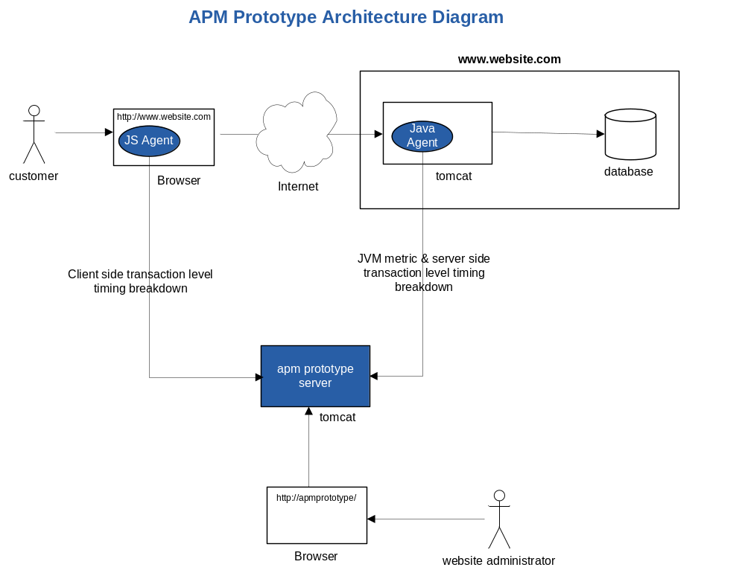

Slide 7
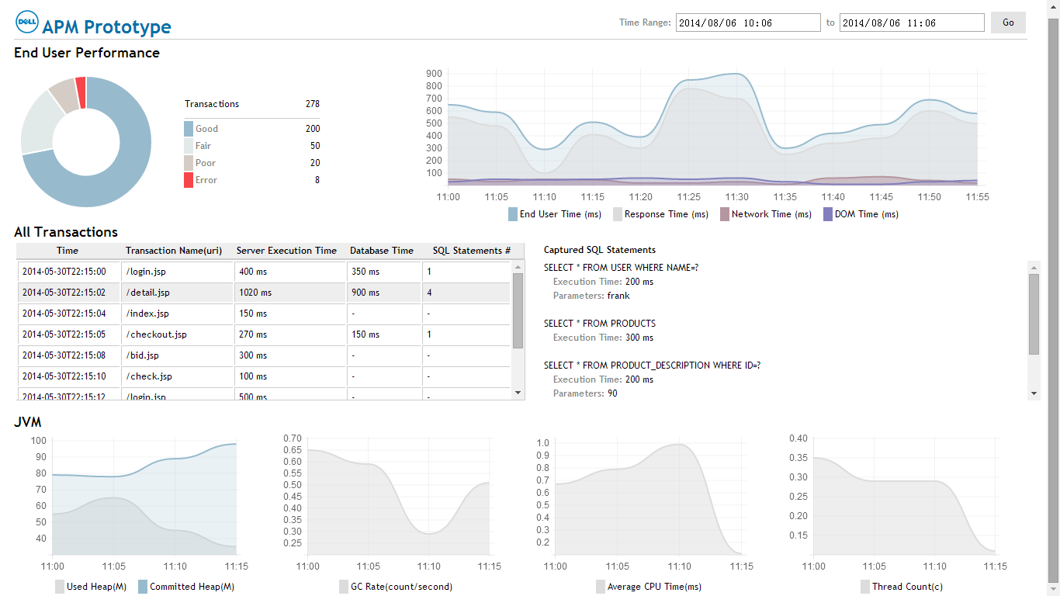
APM Prototype User Interface

Slide 8
What will learn
Understand modern but simplified APM model
Java profiling technologies
  Instrumentation
  JMX
  Binary code access
User Interface
  w3c navigation timing standard
  Standard javascript and ajax
  Standard HTML, css, and part of HTML5

Slide 9
Grouping & Bonus
Required technical skills
  Familiar with Java
  Familiar with JS and HTML
3~4 mates as a group
Mix different language background mates as possible, we just take Java as a sample, implementations in other languages are welcome.
Bonus Tasks
  A document about the improvement of APM prototype.
  A document about how to do performance monitoring in any other programming language, such as PHP, .Net, Ruby, Nodejs and so on. It could be the container (app server) monitor or request tracing monitoring, even better, write down both of them. Some pseudo codes are welcome.

Slide 10
Research those references before lab course
Javascript Navigation Timing
  Navigation Timing
  XMLHttpRequest
Java Instrumentation
  JMX & MXBeans
  Java Instrumentation
  Javassist
  HttpClient
User interface
  HTML5
  Chart.js
  Jquery
Ant build

Slide 11
Thank You
Q&A

